Slide 1

Predicting USA Median Housing Prices by State Using Machine Learning
DSC680-T302 Applied Data Science
Jubyung Ha

Slide 2
Executive Summary
This project develops a machine learning model to predict median housing prices across US states.
Aims to aid real estate investors, policymakers, and financial institutions with reliable housing market forecasts.

Slide 3
Business Problem
Predict median housing prices over the next three years using macroeconomic indicators like interest rates, inflation, and unemployment rates.
Focus on broader economic forces rather than individual house details.

Slide 4
Background/History
Traditional models focused on micro-level details (e.g., house size, location).
Modern approaches leverage machine learning to handle large datasets and uncover hidden patterns influenced by macroeconomic factors.

Slide 5
Data Explanation
Data Sources: Zillow (historical housing prices), FRED (economic indicators), U.S. Census Bureau (demographic information).
Data Preparation:
Date conversion
State abbreviation
Summarization
Missing value imputation
Scaling
Encoding

Slide 6
Data Dictionary
state:
State in the USA.
date:
Date of the data point.
price:
Median housing value.
rent:
Median rent value.
interest_rate: Interest rate.
cp_index: Consumer Price Index.
inflation:
Inflation rate.
total_pops:
Total population.
unemployed_pct: Unemployment percentage.

Slide 7

Methods - Model Selection
Linear Regression: Simple, interpretable, good for linear relationships.
Random Forest: Captures non-linear relationships, robust, handles large datasets well.
XGBoost:
High accuracy, handles missing values, flexible with various hyperparameters.

Slide 8
Methods - Cross-Validation & Hyperparameter Tuning
Cross-Validation: 5-fold cross-validation for robustness.
Hyperparameters:
n_estimators: 100 trees for balance between performance and computational efficiency.
random_state: 42 for reproducibility.

Slide 9
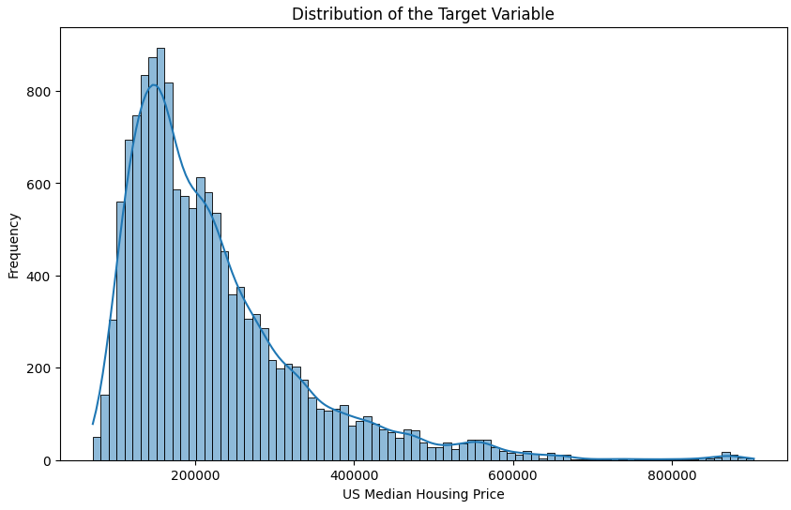
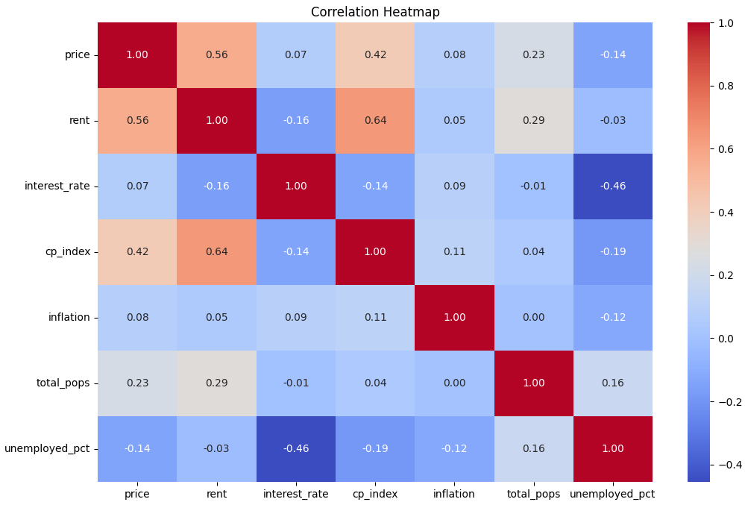
Analysis - Exploratory Data Analysis (EDA)

Slide 10
Model Evaluation – Random Forest
Metrics: R-squared, MAE, RMSE.
Performance:
High accuracy with R-squared of 0.9988
MAE of 1817
RMSE of 4093.

Slide 11
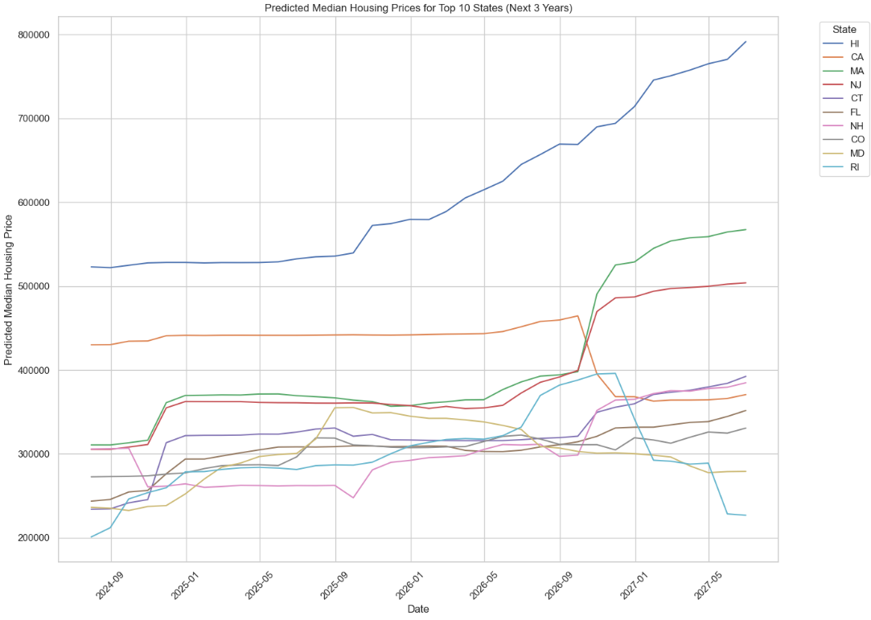
Future Data Generation Assumptions & Prediction
Rent increases by 300 units.
Slight decrease in interest rates by 0.5.
CPI index increases by 10 units.
Inflation increases by 0.1.
Population grows by 300,000.
Unemployment rate decreases by 0.5%.

Slide 12
Conclusion
The model provides high accuracy in predicting median housing prices with the dataset
01
Useful tool for stakeholders to make informed decisions and anticipate market trends
02
The model needs sophisticated assumption for future data
03

Slide 13
Limitations
Relies on linear trends, data quality issues, and complex feature interactions.
Relies on Macro indicators not Micro indicators
May struggle with sudden economic changes, geographic variability, and external shocks.

Slide 14
Challenges
Data collection from various sources.
Ensuring data quality.
Accurately modeling complex feature interactions.
Balancing model interpretability with accuracy.

Slide 15
Future Uses/Additional Applications
Real-Time Analysis: Integrate with real-time data feeds.
Local Market Predictions: Extend to city or neighborhood level.
Policy and Planning: Aid in sustainable development.
Investment Strategies: Provide customized insights.
Consumer Tools: Empower homebuyers and sellers.

Slide 16
Recommendations
Regular updates and maintenance.
Incorporate additional features.
Explore advanced modeling techniques.
Improve model interpretability.
Develop user-friendly interfaces.
Collaborate with domain experts.

Slide 17
Implementation Plan
Google Cloud:
Data processing in BigQuery.
Model development and training using AI Platform.
Deployment with AI Platform Prediction.
Continuous monitoring with Stackdriver.

Slide 18
Ethical Assessment
Concerns:
Data privacy and security.
Bias and fairness.
Transparency and accountability.
Market impact.
Mitigations:
Data protection measures.
Regular audits for bias.
Use interpretable models.
Engage with stakeholders.

Slide 19
Q&A
Why did you choose the specific machine learning algorithms (e.g., Linear Regression, Random Forest, XGBoost) for this project?
Can you explain the data preprocessing steps and why they are necessary?
Which features were found to be the most important in predicting housing prices?
How did you evaluate the performance of your model, and what metrics did you use?
What steps did you take to ensure the model does not overfit the training data?
How did you generate the future data for the predictions?
An R-squared value of 0.9988 is very high. Could this indicate overfitting, and how did you address it?
How can this model be applied in real-world scenarios by stakeholders in the housing market?
What assumptions did you make during this project, and what are the limitations of your model?
What ethical considerations did you take into account while developing this model?

Slide 20
References
Das, S., Karam, P., & Subramanian, S. (2020). The impact of macroeconomic factors on the housing market: Evidence from the USA.
Eversole, T. (2023). Understanding the Influence of Economic Indicators on the Real Estate Market.
Kara, G., & Yilmaz, K. (2021). The effects of macroeconomic indicators on housing prices in Turkey.
ScienceGate. (2021). Impact of macroeconomic indicators on housing prices.
U.S. Department of Housing and Urban Development (HUD). (2023). Comprehensive Housing Market Analyses Archive.

